Slide 1



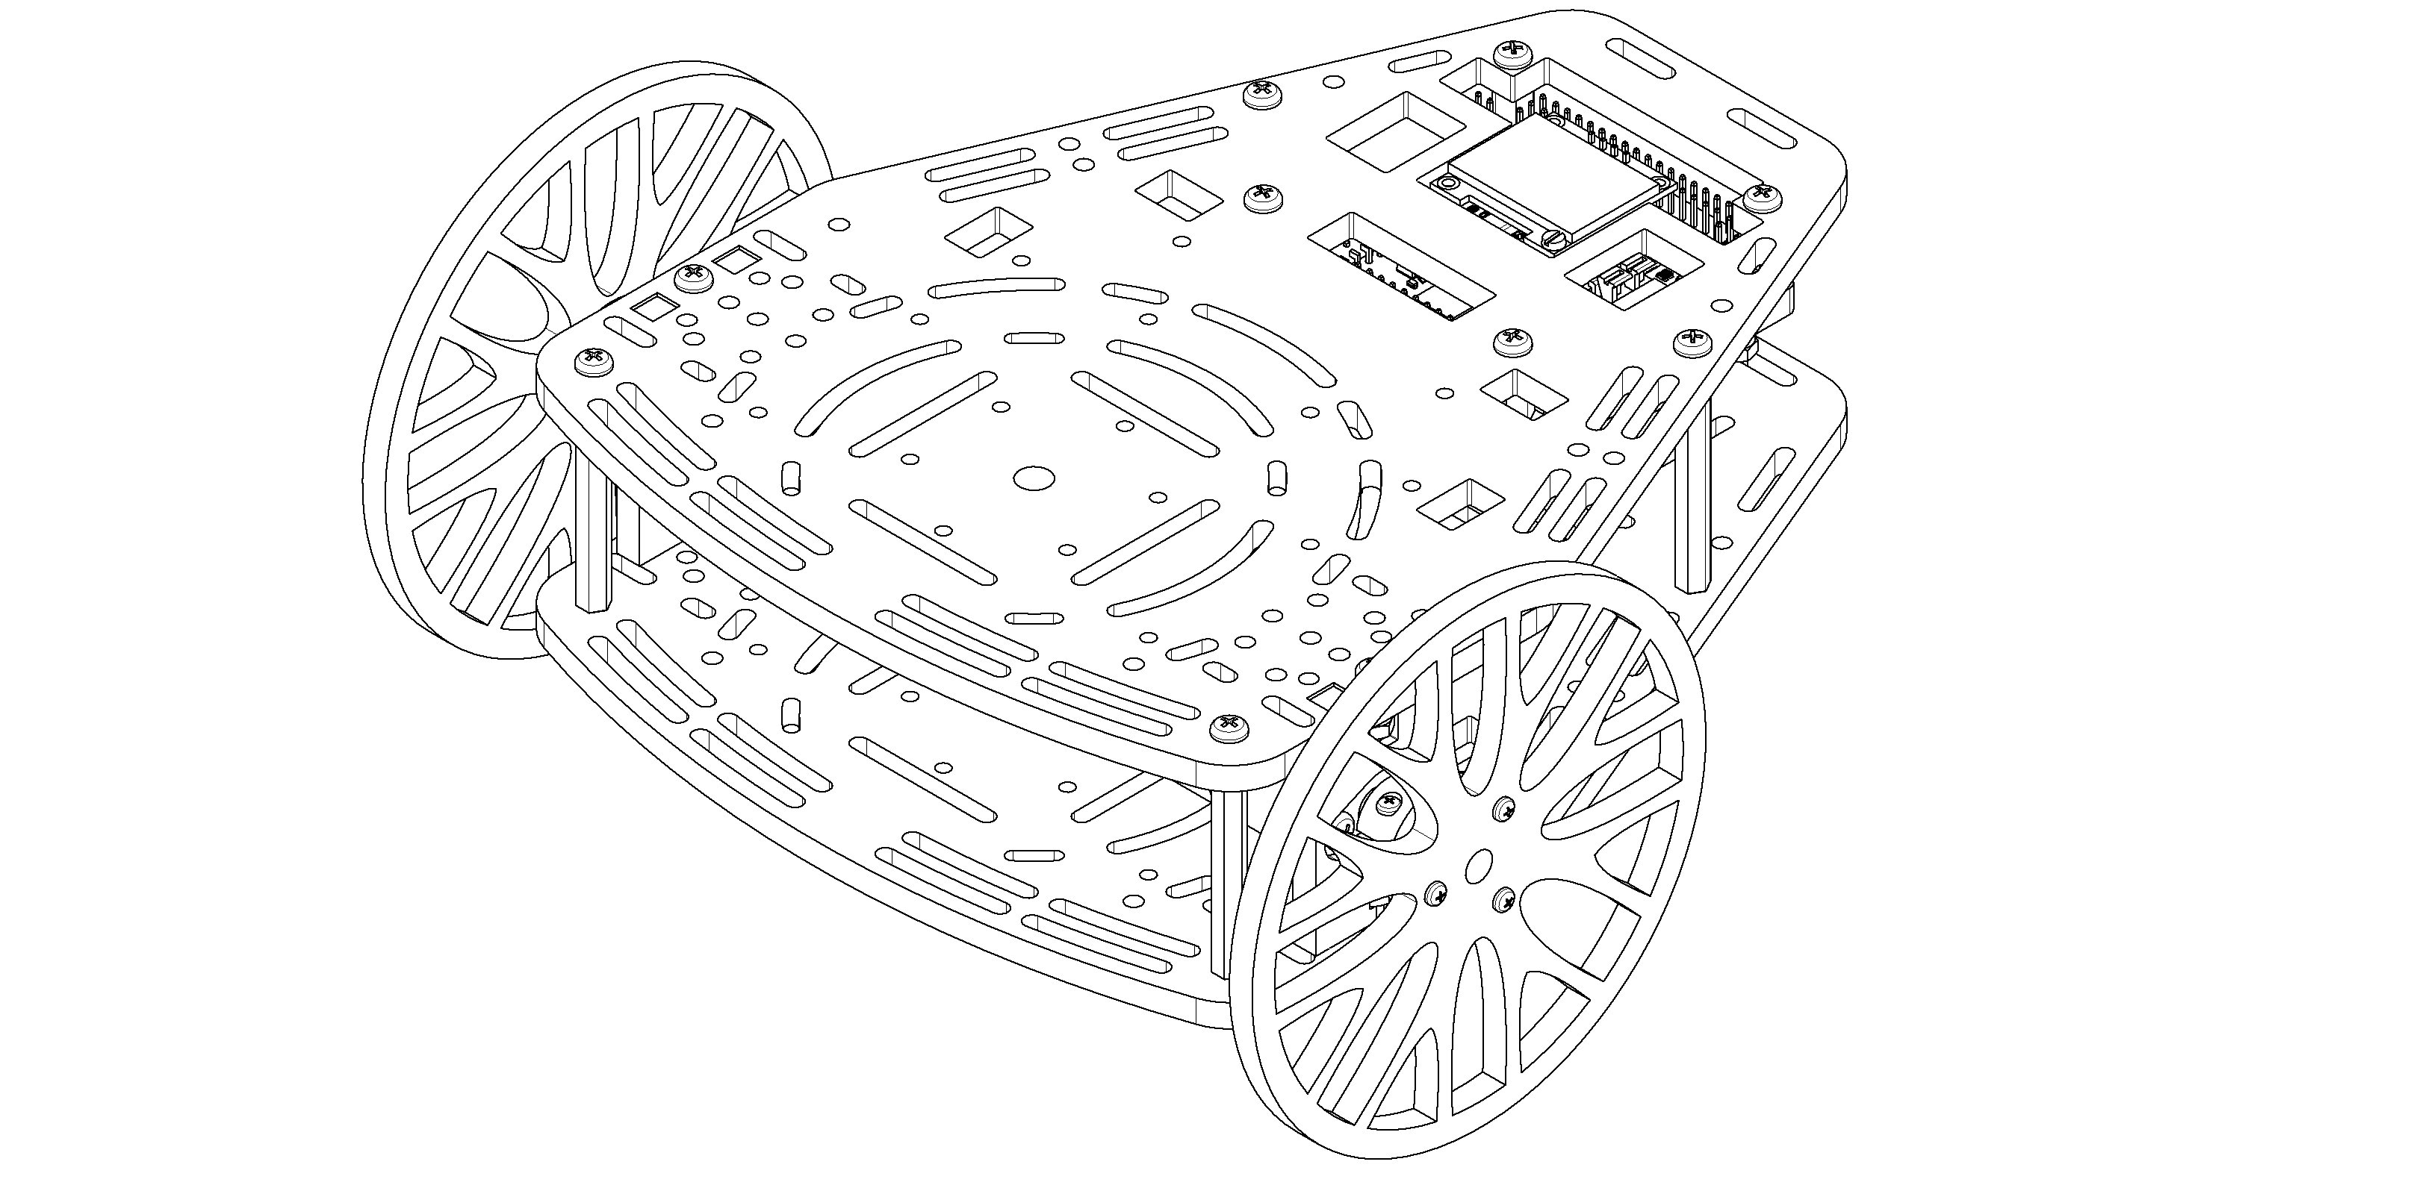
Introduction to ROS
From zero to a functional communication scheme

Slide 2
Schedule for the day
Morning Content
What is ROS
How is ROS communication done
Terminal tools
Talker and listener
Lunch pause
Afternoon Content
ROS Launch
Advanced concepts from ros
Activity
Questions

Slide 3

ROS basics What is ROS ?
“ROS is an open-source framework that helps researchers and developers build and reuse code between robotics applications”
Notes:
Basically define ROS In one sentence to place the students, What is ROS and Where is it used
Move onto the example, smthing like so that you can understand it better bla bla bla

Slide 4
ROS basics The conceptual idea behind ROS
University
Teacher 1
Teacher 2
/ROS
/Control
/ROS
Student B
/Weekend
/Control
Student C
Student A
/Party
Student D
Notes:
Imagine that you are attending a lecture, in that case the infrastructure that makes it possible is the University (ROS Master) where you attend a certain room (subscribe to a topic) so that you can listen a teacher. Within the same Building other lecturers are talking to their students similarly and at the same time students get to talk to each other about what are they going to make during the weekend and which party are the going to attend. In ROS, the system that makes the whole thing possible is known as ROS Master. People attending to classes are nodes and the mean of communication are known as topics

Slide 5
ROS basics What is the information delivered?
Any class has a certain format, which both the teacher and the student know off and is expected to be followed.
Between two friends you are not expecting a power point presentation but some plain text
Publishers
Data types
Subscribers
Teacher
/ROS
Presentation and a
practical explanation
Students
Student
/Weekend
Plain text and memes
Student
Notes:
If the structure is wrong you won’t understand it, same happens to ROS
Each topic has a particular type associated to it, For the computer they are always 1 and 0, so we need some way to decode it

Slide 6
ROS basics ROS versions and installation
New version of ROS are released with each Linux distributions, due to compatibility in this course we are going to be working with ROS melodic (released with Ubuntu 18.04).
Instructions for the installation can be found in:
http://wiki.ros.org/melodic/Installation/Ubuntu
Currently there’s another version of ROS available for Ubuntu 20.04 and a revision of the ROS structure, known as ROS2, that aims to increase the robustness of the framework for industrial applications and distributed systems.
Notes:
Explain that ROS versions are update more or less annually, and that more than one of them at a time is maintained
Explain that we use melodic due to Nvidia and older projects compatibility
Explain the existence of ROS2 -> Introduced to provide a decentralized structure, real time aplications and enhance communication security between subsystems

Slide 7
ROS Architecture ROS Master
Brain of ROS -> Process manager that enables the communication between different agents in the network.
Allows communication between different computers or robots by means of a Server – Client architecture
ROS Master
User
Node 2
TCP IP Com
User
Node 1
Robot
Node
ROS Serial
Arduino
Node
Notes:
ROS MASTER is the brain of ROS, going back to the University is the administration staff that books a room for you and makes sure that students attend the correct lectures, or in a online lecture the role of zoom

Slide 8
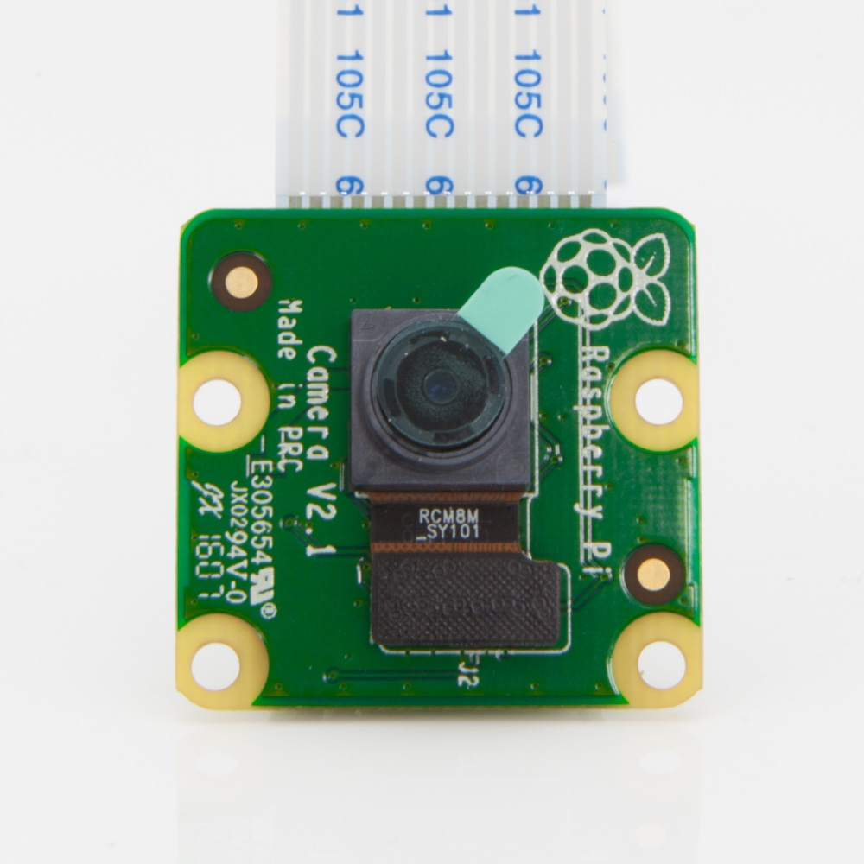
ROS Architecture nodes and topics
Piece of software that acts as an element in the network.
It is in charge of executing a part of the code and can be programmed in Cpp, Python or Lisp.
Each topic has a unique msg type.
Hardware
Node
Node
Obstacle detection
node
Get
data
/Image
Node
Cables
White line detection
node
Notes:
Mention how cool it is to have a camera node done by someone else that deals with the hardware for you
Nodes make sure to standardize the information along the ros network
Example with different models of cameras f.e by changing your node sony and Logitech cameras would work in the same way regarding your code
Remark difference between the parsing node and our node

Slide 9
ROS Architecture messages
std_msgs/Float32
geometry_msgs/PoseStamped
std_msgs/Header header
uint32 seq time stamp string frame_id geometry_msgs/Pose pose
geometry_msgs/Point position
float64 x float64 y float64 z geometry_msgs/Quaternion orientation
float64 x float64 y float64 z float64 w
float 32 data
sensor_msgs/Image
std_msgs/Header header uint32 height uint32 width string encoding uint8 is_bigendian uint32 step uint8[] data
Notes:
Talk about how msgs can be 1 variable, vectors of variables and can embed different msg types

Slide 10
ROS Architecture services and actions
While topics are one way communication, services and actions allow feedback in the communication. They are used to eliminate unnecessary communication.
Services follow a question-answer structure, while actions are designed to execute a task and give feedback during the process.
Control Node
User Input Node
Can you send me a path ?
Move to point A
Updated path
Updates:
Current pose
Success !
Planning Node
Control Node
Service
Action
Notes:
Explain how Service and actions are used to avoid having redundant msgs in our network
Emphasis on the option of having two-way communication

Slide 11
ROS Architecture Services and actions
When defining either an action or a service we need to stablish each member involved in the communication. Usually both are project dependent, so users define their own structure
Actions
Service
Request
Request
int64 a
int64 b
int64 a
int64 b
-----------------
-----------------
Feedback
Response
int64 c
int64 c
-----------------
Response
int64 d
Notes:
Comment their structure and compare them with the msgs structure

Slide 12




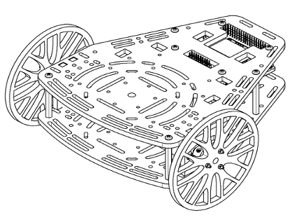
ROS Architecture A practical example
PC
Notes:
Relate the theory explained with an example of a physical robot (relate to the experiments that we are gonna do afterwards in the course)

Slide 13
ROS Architecture Overview
Ros Master
Jetson
Arduino
User
Node
Sensors
Node
Control
Node
Actuators
Node
Physical System
ROS Implementation
Notes:
Remark physical layer and software
Relate with class example
Relate each element In physical system with a part of the ROS Implementation

Slide 14
ROS Architecture ROS Packages
Ros Packages are a way of organizing codes related between each other.
The same way teachers are gathered within the Engineering school nodes are gathered in ROS packages
Engineering School
Camera Package
EEE
MACE
Data acquisition
Video
recording
CompSci
ChemEng
Video display
Notes:
The way of explaining packages will be relating it to a school in the University, different ”families” within engineering

Slide 15

ROS Code Talker and listener framework
Simplest communication scheme.

Slide 16
ROS Code Talker
rostopic echo
#!/usr/bin/env python import rospy from std_msgs.msg import String
if __name__ == '__main__': pub = rospy.Publisher("chatter", String, queue_size=10) rospy.init_node("talker") rate = rospy.Rate(10)
while not rospy.is_shutdown(): hello_str = "hello world %s" % rospy.get_time() pub.publish(hello_str)
rate.sleep()
Setup environment and import libraries
Create variables and setup node
Publish message
Wait to run again
Terminal Commands
roscore
rosrun basic_comms talker.py
rostopic echo /chatter
File Location
home/catkin_ws/src/chatter/src/talker.py
Notes:
When setting up nodes, node names must be unique
Sleep matches the rate Hz, it is not a fixed sleep for 0.1s
ROS will do its best to match the desired rate, but it’s not real-time so the rate will not always be accurate

Slide 17
ROS Code Listener
rostopic pub
#!/usr/bin/env python import rospy from std_msgs.msg import String
def callback(msg): rospy.loginfo("I heard %s", msg.data)
if __name__ == '__main__': rospy.init_node('listener') rospy.Subscriber("chatter", String, callback)
rospy.spin()
Setup environment and import libraries
Define Callback
Create variables and initialise node
Continuously check for new messages
Terminal Commands
roscore
rosrun basic_comms listener.py
rostopic pub /chatter <tab complete>
File Location
home/catkin_ws/src/chatter/src/listener.py
Notes:
Callbacks must be really short
Blank our listener in this and talker in the next

Slide 18
ROS Tools ROS Terminal tools
roscore
Must be executed before working with ros
Handles the correct functionality of the network
rostopic
Contains useful tools related with topics
rostopic echo [topic name]
rostopic list
rostopic hz [topic name]
rosrun
Executes a given node
rosrun [package] [node name]
rosnode
Contains useful tools related with nodes
rosnode list
rostopic info [node]

Slide 19
ROS Tools ROS Terminal tools II
roslaunch
Allows to launch multiple nodes with a single command by calling .launch files
roslaunch [package] [.launch]
rosbag
Records the activity of the topics in the network
rosbag record
rosbag info [bag file]
rosbag play [bag file]
config files
Load parameters into the system that can be accessed by any node
rqt
ROS visualization tool that provides graphical information of the system status

Slide 20
FOR LECTURER ONLY: ros terminal tools
Share screen, open the terminal and briefly explain what it is
Execute a ROScore and some nodes
Echo the listener and the talker to show how to get feedback from them
Use rostopic tools
Use rosnode tools to check the architecture of the system
Use rqt to generate the plot of the system
Notes:
Demonstrate how is ROS set up in the terminal, what are the good practices, set up and some of the useful tools that can be used

Slide 21
Activity Implement a listener-talker
Implement the code in either Python or Cpp (You can find a commented version of the Cpp code in the handout)
Use some of the command line tools to verify the correct functioning of the system.
Notes:
Videos of gazebo doing it instead of image

Slide 22
ROS Tools ROS Parameter Server
ROS allows to load variables into the master which are accessible by all the nodes of the system.
Typically, a .yaml file is loaded into the system through a launch file and configuration parameters are stored there.
It is very typically to use them when loading robot models or constants that may vary in different scenarios where the same code is applied.
An example of a config file can be found in [path in project]
ROS Core
Control Node
Config.yaml
roslaunch
Parameter Server
Planning Node
Notes:
Explain that ROS allows to load information in its system
Very useful to store system hyperparameters and change them easily during the testing phase fe you could have all the hyperameters for a given image recognision task in the same file and iterate though them without having to change the main code or recompile the system. If your application changes you only have to copy and paste the config file

Slide 23
ROS Tools ROS Launch
Master
ROS Launch
Node 1
Node 2
Config files
Notes:
Lanch scheme

Slide 24
ROS Tools ROS Launch Syntax
Launch files are sets of commands written in xml that allow executing various scripts at the same time.
The general syntaxis is the following
<?xml version=“1.0”?>
<launch>
[Body of the launchfile]
</launch>
This syntaxis allows to run any object used within the ROS architecture and has a wide variety of tools that allow to parametrize the launch file so that it can be adapted to the requirements of you project.
An extensive documentation can be found in http://wiki.ros.org/roslaunch
Notes:
Roslaunch basics

Slide 25
ROS Tools ROS Launch code tools
Running a node
<node name=“listener” pkg=“basic_comms” type=“listener.py” output=“screen”/>
Running another launch file
<include file="$(dirname)/other.launch" />
Set parameters (add file)
<param name="publish_frequency" type="double" value="10.0" />
Pass args to the launch file
<arg name=”camera_id" value=”cam_3" />
Notes:
Some code lines used to make the launch files

Slide 26
ROS Tools ROS Launch example
home/catkin_ws/src/chatter/launch/chatter.launch
<?xml version=“1.0”?>
<launch>
<node name=“listener” pkg=“basic_comms” type=“listener.py” output=“screen”/>
<node name=“talker” pkg=“basic_comms” type=“talker.py” ouput=“screen”/>
</launch>
roslaunch basic_comms chatter.launch
Notes:
Go through the code

Slide 27
FOR LECTURER ONLY: launchfiles
Here we should share screen and open a launch file that we can use as a example to go through the code of one of the files that we are using + questions, relating to the tools provided in the previous slide

Slide 28
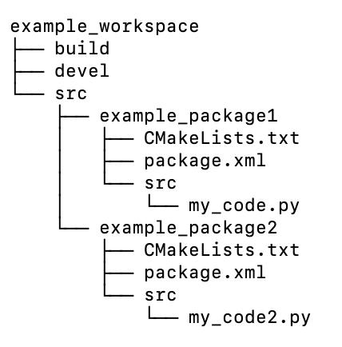
ROS Tools ROS File structure
ROS projects are organized using workspaces, which are a collection of grouped codes called packages.
Instructions for the compiler need to be allocated in .cmake and package files
Package files are exportable between projects
Configuration files used to stablish code dependencies
Code that we will execute
Catkin_make will generate ‘src’ and ‘devel’ for you when compiling the workspace
Notes:
Mention that we need to compile the packages and add dependencies even if we are working on python
Mention catkin!!

Slide 29
ROS Tools ROS Compilation tools
ROS requires to compile each package, generating dependencies related with other packages, external libraries or custom messages, services and actions.
The preferred compilation tool is known as catkin and uses two separated files, package.xml and CMakeLists.txt.
An useful command to create packages is:
catkin_create_pkg [name] [list of dependencies]
Which generates an empty package and templates of both CMakeLists and package files.
More information about the syntaxis of this files can be found In http://wiki.ros.org/ROS/Tutorials/CreatingPackage
Projects are compiled with the instruction catkin_make and the instruction source [project]/devel/setup.bash needs to be executed to load the changes.
Notes:
Launch launches roscore automatically if necessary

Slide 30
FOR LECTURER ONLY: catkin
Here we should share screen and go through the file structure of a project, showing where the different folders need to be placed, what are the templates generated when creating a package and how to fill them
We can use the example of talker listener and go trough the template
Notes:
Launch launches roscore automatically if necessary

Slide 31
Example Using custom messages
Create a folder called msg in your workspace.
Make a custom msg definition with a Header and a Float32.
Open both CMakeLists and package.xml and modify them to compile our new msg.
Modify the code of the previous activity using the new msg definition.
package/StampedCmd
std_msgs/Header header float32 data
Notes:
Teacher make this steps sharing the screen, using the opportunity to show a Cmake List and a package.xml

Slide 32
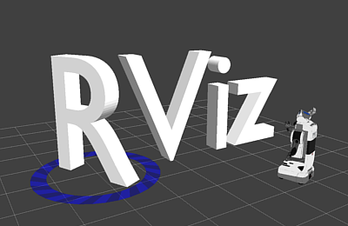
ROS tools Rviz visualization tool
Rviz is a program used to visualize 3D representations of any system simulated with ROS.
Is commonly used to represent sensor information, such as point clouds, spatial relationship between elements using transform frames or robots.
Remember that Rviz is only a visualization tool, it does not allow any kind of simulation.
Control Node
Planning Node
Notes:
Teacher make this steps sharing the screen, using the opportunity to show a Cmake List and a package.xml

Slide 33
FOR LECTURER ONLY: E1
Demonstrate the contents of the next slide, and keep the slide as a reference for the students
Notes:
Launch launches roscore automatically if necessary

Slide 34
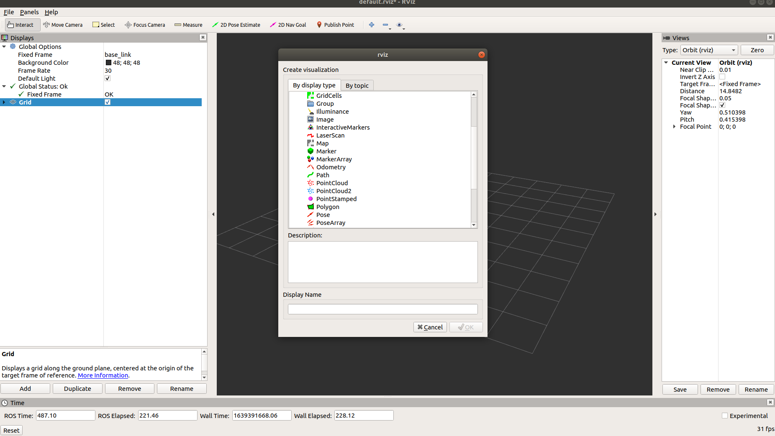
RViz Example Displaying information from a camera
In order to display information from a camera we need to follow these steps
Set up a fixed frame that acts as the origin of our world
Select a topic containing the images that we want to display
“Global options” allow to set up a common reference frame and background for all the objects visualized
The ”add” tab is used to manage information
Notes:
Teacher shares screen and plots info from the robot, f.e setting a camera

Slide 35
FOR LECTURER ONLY: E2
Demonstrate the contents of the next slide, and keep the slide as a reference for the students.
In this second demonstration show how the world can be saved and opened afterwards (contents of the next slide )
Notes:
Launch launches roscore automatically if necessary

Slide 36
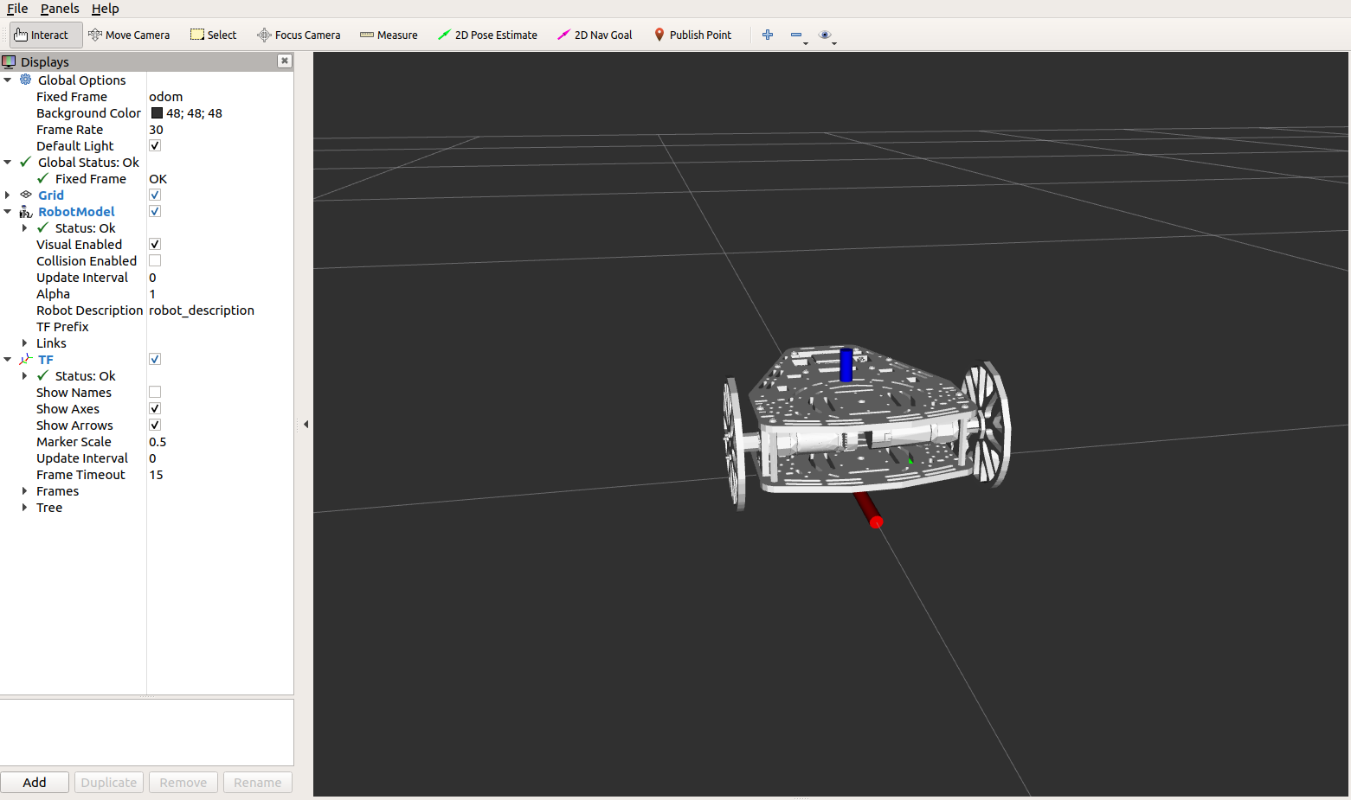
RViz Example Loading and moving a robot in Rviz
In order to display the movement of a robot in Rviz we need to follow these steps:
Set up a fixed frame that acts as the origin of our world
Add a robot object
Link it to a 3D model and a topic describing its state
“Global options” allow to set up a common reference frame and background for all the objects visualized
The ”RobotModel” tab is used to link a robot model (Robot Descriptor) and position information (links)
Notes:
Teacher shares screen and plots info from the robot, f.e setting a camera

Slide 37
ROS tools Saving and opening Rviz configurations
Once your Rviz environment is properly set up you can save it using the tab file -> save, this generates a .rviz file that can be launched within any roslaunch file.
The code used to do so is the following and can be added to any of the ros files
<node name=”rviz” pkg=“rviz” args=“-d [file path]” required=”true” />
Remember that if your rviz required a robot model it need to be loaded into the system by adding
<param name=”robot_description” coomand=[model path]/>
This will execute your code along with an Rviz window, allowing to display the information that you find relevant to your application
Notes:
Teacher make this steps sharing the screen, using the opportunity to show a Cmake List and a package.xml

Slide 38
Activity Problem architecture
Ros Master
Simulator
Task
User
Node
Control
Node
Model
Node
ROS Implementation
Notes:
Add marcs image, and mario’s image

Slide 39
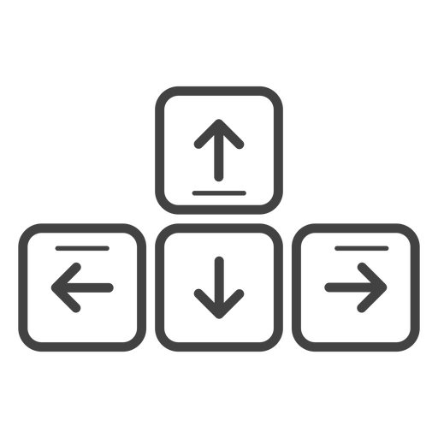
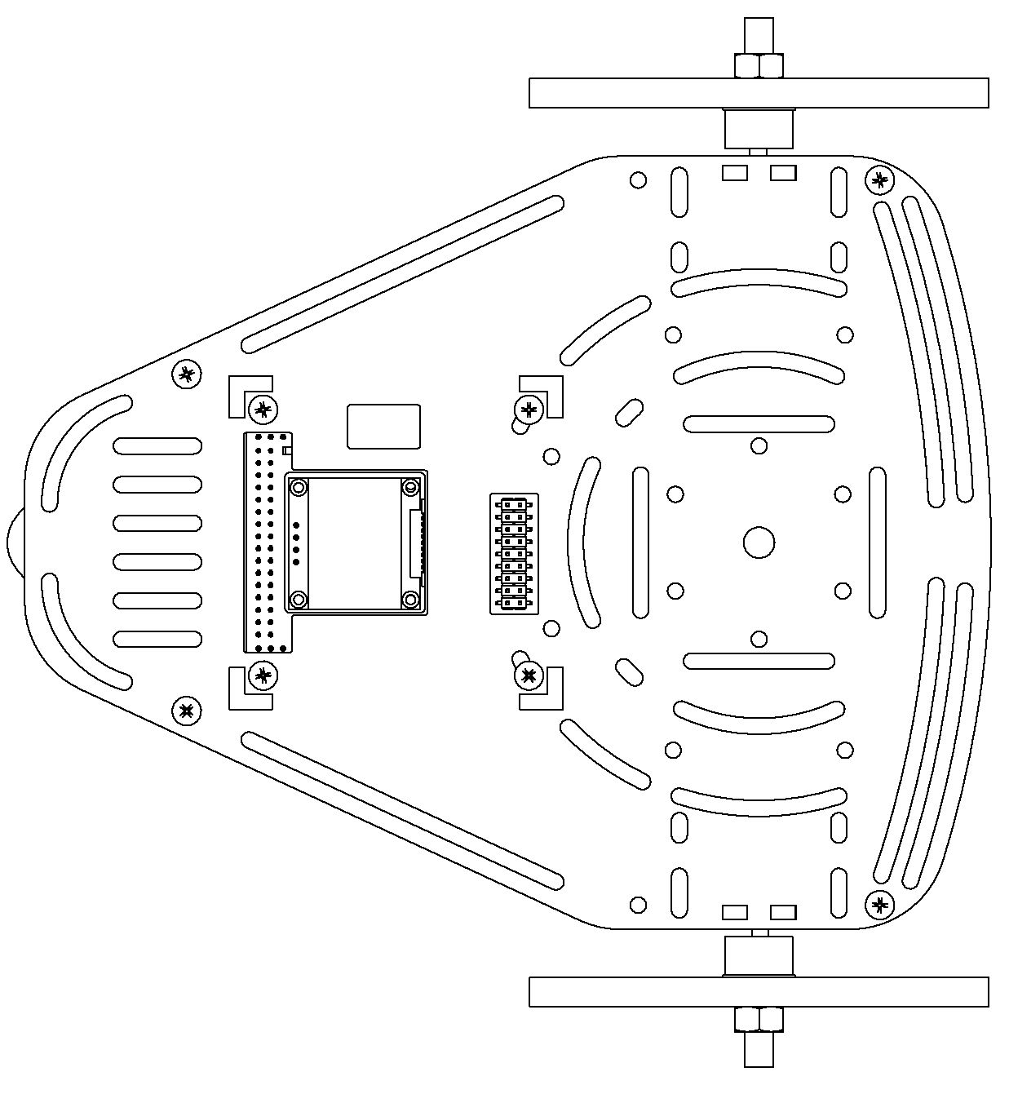
Activity Teleoperate a PuzzleBot
Teleoperation
Square
Input in the terminal the commands to move the robot
See how the robot traverses accordingly the environment.

Slide 40
Activity How is the robot modelled?
Notes:
Add marcs image, and mario’s image

Slide 41
Activity Moving a PuzzleBot
Straight line
Square
Drive the robot in a straight line.
Drive the robot making a square with a side length of 1m.
Modify the file “square.py” inside the puzzlebot package.

Slide 42
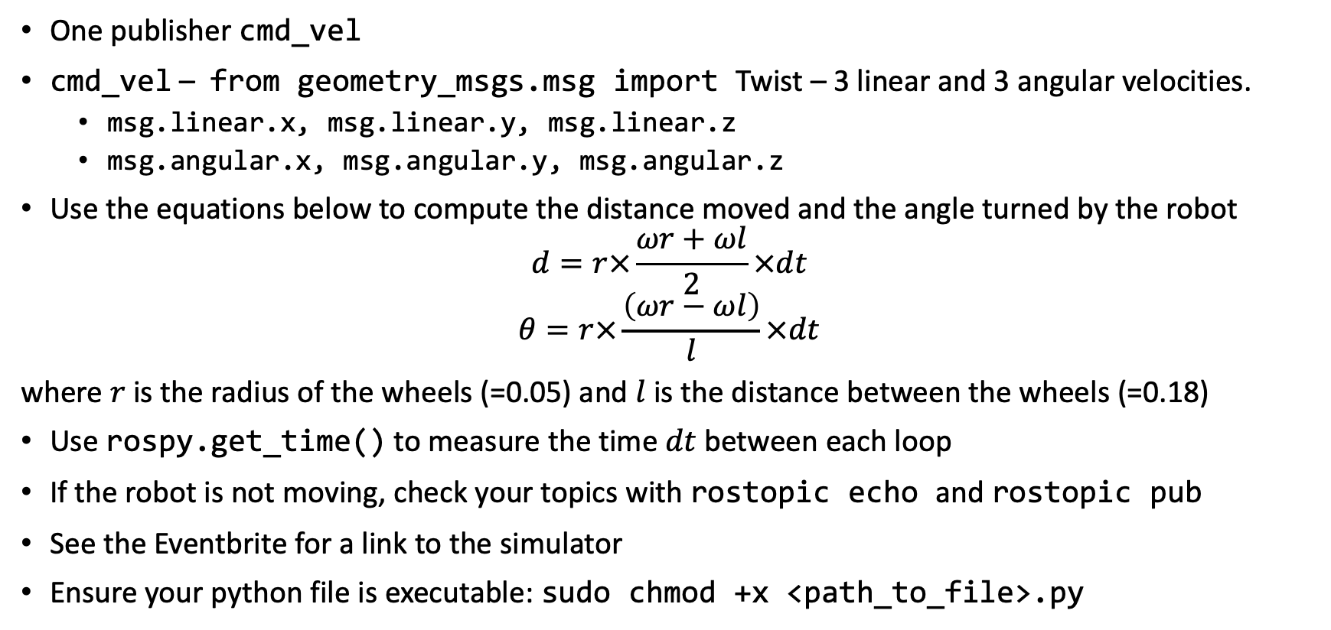
Activity Some tips and tricks
One publisher cmd_vel
cmd_vel – from geometry_msgs.msg import Twist – 3 linear and 3 angular velocities.
msg.linear.x, msg.linear.y, msg.linear.z
msg.angular.x, msg.angular.y, msg.angular.z
Use the equations below to compute the distance moved and the angle turned by the robot
$$d=r×\frac{ωr+ωl}{2}×dt$$
$$θ=r×\frac{\left(ωr−ωl\right)}{l}×dt$$
where $r$ is the radius of the wheels (=0.05) and $l$ is the distance between the wheels (=0.18)
Use rospy.get_time() to measure the time $dt$between each loop
If the robot is not moving, check your topics with rostopic echo and rostopic pub
See the Eventbrite for a link to the simulator
Ensure your python file is executable: sudo chmod +x <path_to_file>.py

